Slide 1
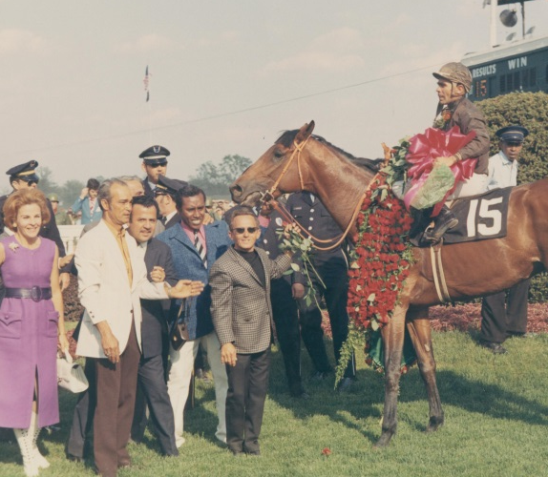
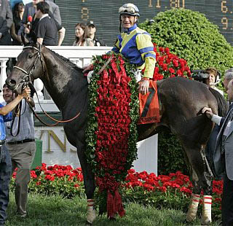
Winner’s
Circle
Geography

Slide 2
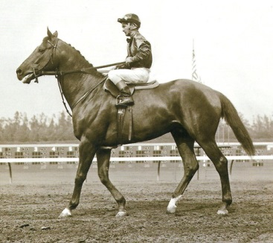
Winner’s Circle Geography
My name is Swaps. I came from the “Golden State”. My state is the home of Disneyland and the Dodgers. It is bordered by Oregon, Nevada and Arizona.
I am from _______________.
California
4

Slide 3
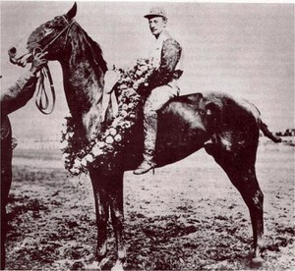
Winner’s Circle Geography
My name is Wintergreen. The capital of my home state is Columbus and is known as the Buckeye State. This state shares a border with Kentucky.
I am from _______________.
Ohio
1

Slide 4
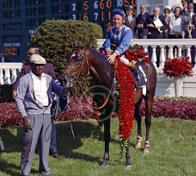
Winner’s Circle Geography
My name is Kauiai King and I’m not from Hawaii, although I was named after a Hawaiian island. I come from one of the original thirteen colonies and the capital is Annapolis. My state is also home to the Preakness which I also won.
I am from _______________.
Maryland
1

Slide 5
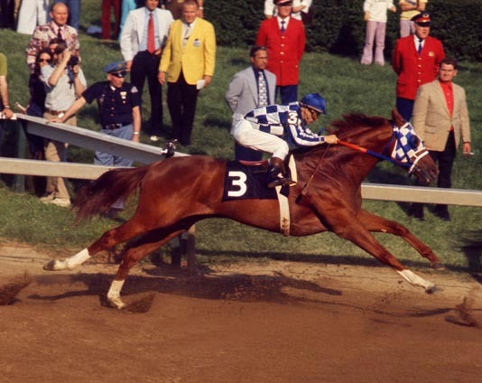
Winner’s Circle Geography
You might have heard of me. My name is Secretariat. I come from the same state as George Washington. North Carolina, Kentucky, West Virginia, Tennessee, Maryland and the Atlantic Ocean all border my state.
I am from _______________.
Virginia
4

Slide 6
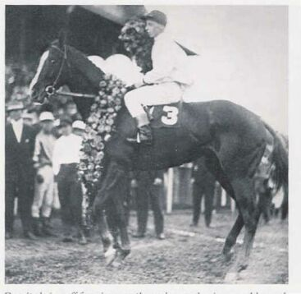
Winner’s Circle Geography
My name is Regret and I was the first girl horse to beat the boys in the Derby. I come from a small, but populous state known as the “Garden State”.
I am from _______________.
Girl power!
New Jersey
2

Slide 7
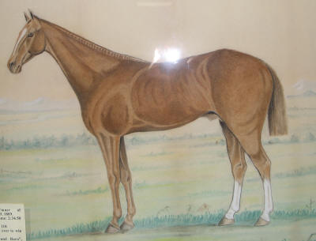
Winner’s Circle Geography
My name is Spokane. I am from the fourth largest state in the nation. The capital of my state is Helena, and my state is home to the Roe River, the world’s shortest river at only 200 feet long.
I am from _______________
Montana
1

Slide 8
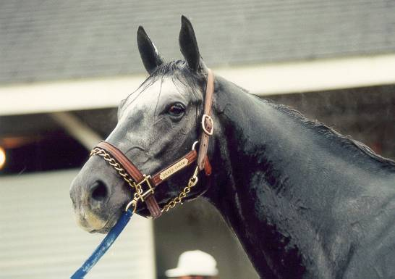
Winner’s Circle Geography
Silver Charm is my name. I live in Kentucky now, but I was born in the “Sunshine State”, home to many beaches and alligators.
I am from _______________
Florida
6

Slide 9
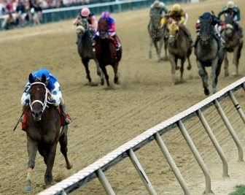
Winner’s Circle Geography
My name is Smarty Jones. I am from the “Keystone State”. Our largest city is Philadelphia, although our capital is Harrisburg. Although famous in Kentucky, both Daniel Boone and Stephen Foster were from my state.
I am from ___________________.
Pennsylvania
2

Slide 10
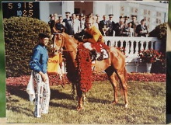
Winner’s Circle Geography
My name is Dust Commander. I came from the “Land of Lincoln”. It is home to the Bears and Cubs, and the largest city in the Midwest.
I am from _____________.
Illinois
1

Slide 11
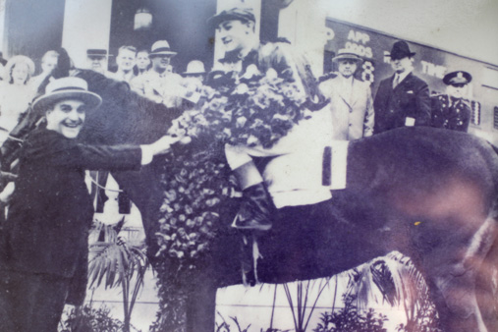
Winner’s Circle Geography
My name is Lawrin. Topeka is the capital of this “Sunflower State”. Nebraska, Missouri, Oklahoma and Colorado border this prairie state. Dodge City is the windiest city in the United States.
I am from _______________
Kansas
1

Slide 12
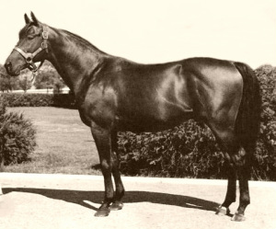
Winner’s Circle Geography
My name is Middleground. I come from the second largest state in the United States, although at one time it was a part of Mexico. It is home to the Cowboys and the Rio Grande.
I am from _______________.
Texas
2

Slide 13
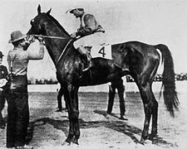
Winner’s Circle Geography
My name is Elwood and I am from the “show-me” state. Writer Mark Twain lived in this state and based many of his writings on the Mississippi River which borders to the east. The capital is Jefferson City.
I am from _______________.
Missouri
1

Slide 14
Winner’s Circle Geography
My name is Lord Murphy. I come from a state known for its country music. We are known as the “Volunteer State” and home to the Smoky Mountains. We border Kentucky to the south.
I am from _______________.
Tennessee
3

Slide 15
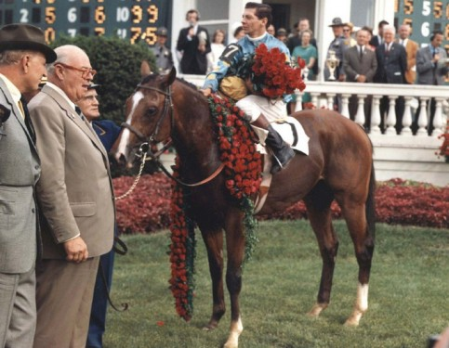
Winner’s Circle Geography
My name is Northern Dancer. I am from the country that borders the United States to the north. My country doesn’t have states, we have provinces. Our capital is Ottawa and largest city is Toronto.
I am from _______________.
Canada
2
How many Derby winners from this country?

Slide 16
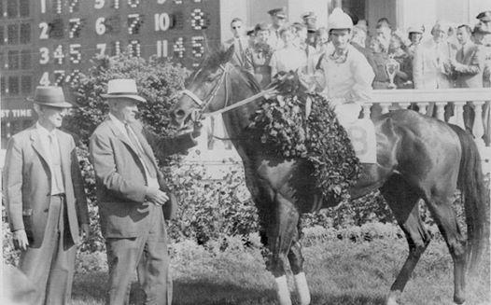
Winner’s Circle Geography
I am Tomy Lee. I come from a country in Europe and that is part of Great Britain. Our capital city is London and thoroughbreds were first bred here in my country.
I am from _______________
England
2
How many Derby winners from this country?

Slide 17
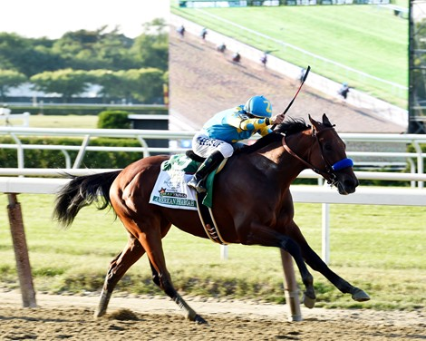
Winner’s Circle Geography
My name is American Pharoah and I am from the “bluegrass state”. My state is known for its many horse farms and is home to the world’s most famous horse race.
I am proud to be from
_______________.
Kentucky
110

Slide 18
Winner’s
Circle
Geography

