Slide 1
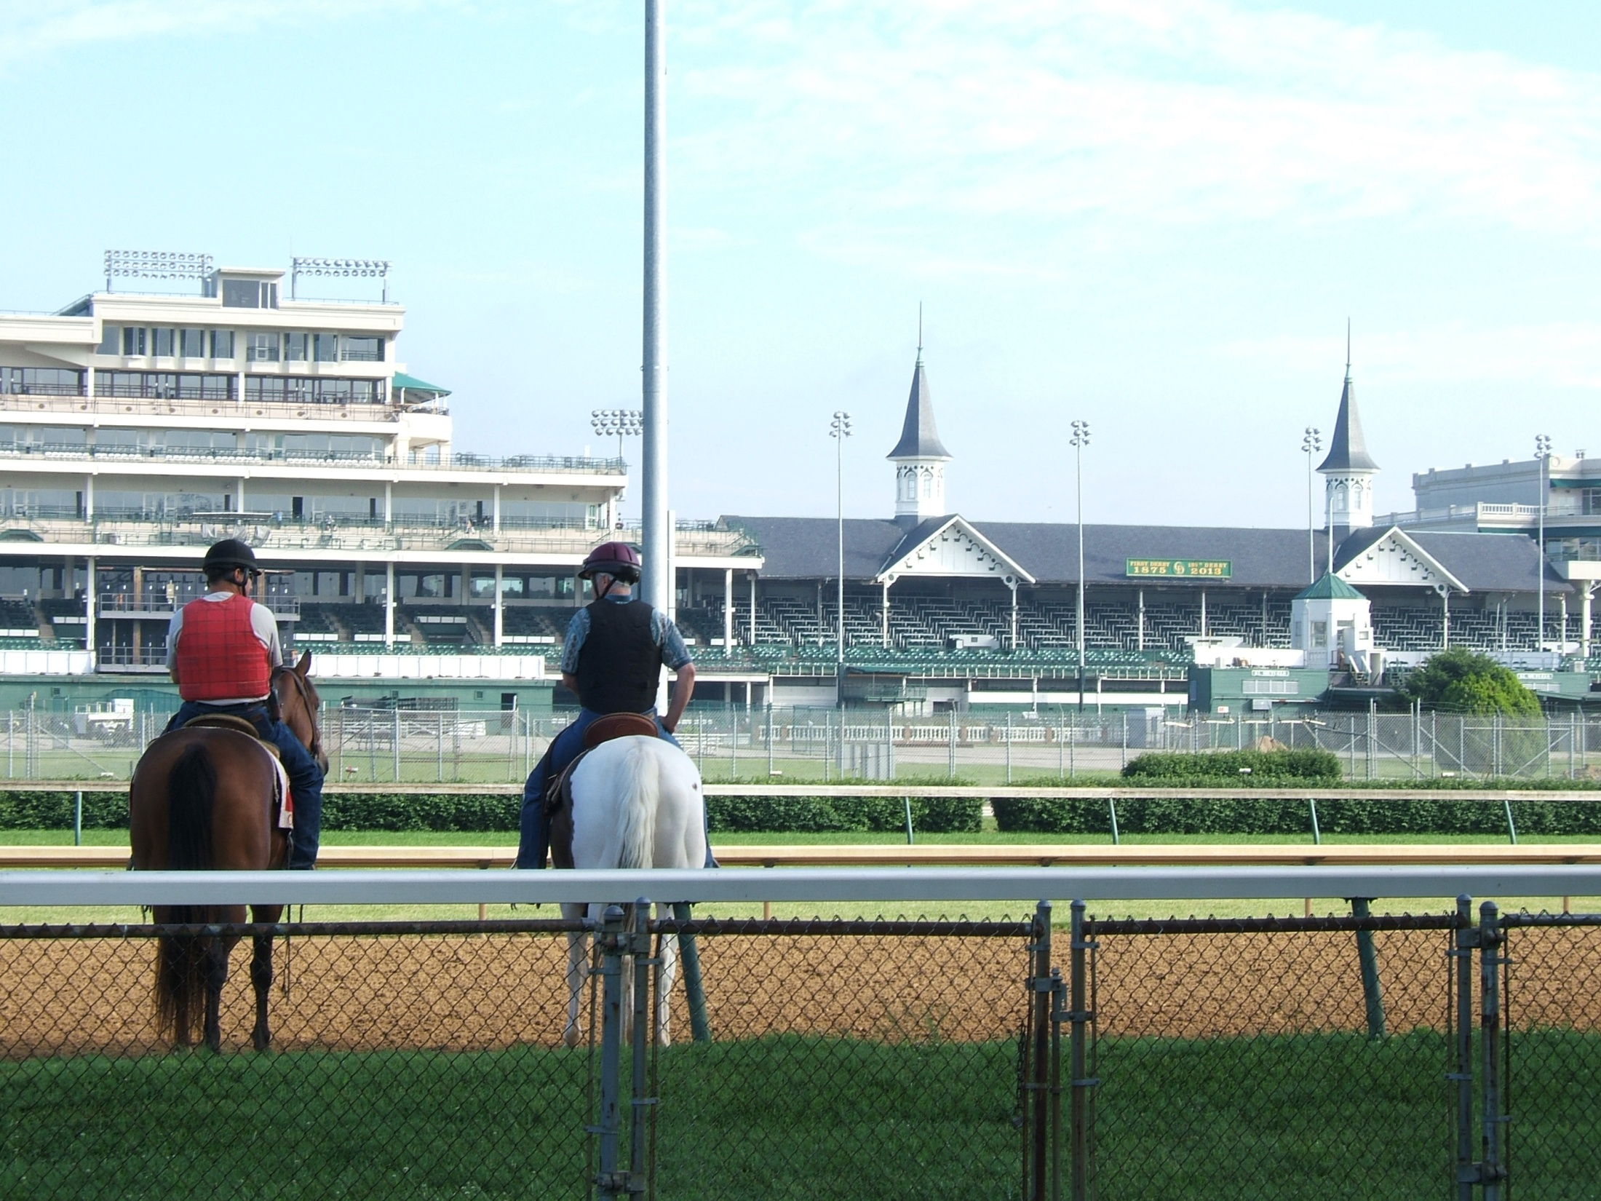
Horsing Around With Art 2022-2023

Slide 2
Themes of Awards
Grand Prize- “Captures the spirit of the Derby”
The Winston Memorial Award- “Illustrates the importance of companionship in the horse’s life provided by either humans or other animals”
Millinery Fashion Award- “Best embodies Derby fashion”
Thoroughbred Award- “Represents the beauty or athleticism of the Thoroughbred Racehorse”
Backside Award- “Portrays life on the Backside at Churchill Downs”
The Outriders Society Award- “Showcases the traditions of the Derby”
Sculpture Award- “Most outstanding piece of Derby related 3D Art”
Employees’ Choice Award- “Voted as favorite of KDM Employees”
Viewers Choice Award- “Voted as favorite of the online exhibit”

Slide 3
Common Horseracing Vocabulary
Backside- The area away from the grandstand side of the track, usually where the stables are located. It often includes sleeping rooms, a kitchen and recreation areas for stable employees. Exercise Rider- The person who rides the horse during the morning workouts, different than a jockey. Farrier- The person who puts horseshoes on the horse and trims the hooves. Furlong- An eighth of a mile on the racetrack. Groom- The person who cares for a horse in a stable; or, to clean and brush a horse. Hand- The unit of measure for the height of a horse; a hand is four inches. Hot Walker- Person who walks the horse until it is cooled off after its morning workout. Jockey- The person who rides the horse during a race. Morning Workouts- Training time for horses to practice being around and running on the race track, usually done early in the morning. Churchill Downs is open from 6:00 am – 10:00 am for morning workouts. Paddock- Area of the racetrack where the horses are saddled before the race; where the jockey mounts the horse. Schooling- Introducing young horses to the race track, starting gate and paddock area; teaching them how to behave there, normally done during the morning workouts. Silks- The jacket and cap worn by a jockey in a race, they indicate who owns the horse.
Tack- The rider's racing equipment. The tack room is where the equipment is kept in a barn. Thoroughbred- A breed of horse created in England in the early to mid-1700s, the only one bred solely for speed. Trainer- The person who is responsible for preparing the horse to run the best that it can, he or she plans what the horse will do each day in the morning workouts. Triple Crown- A series of three races for three year old colts & fillies: the Kentucky Derby, the Preakness Stakes & the Belmont Stakes; run each year during May & June.

Slide 4
The Backside
The Backside of Churchill Downs employees over 900 people.
It’s like a city within Churchill Downs and everything revolves around the Thoroughbred.
The Backside is open from mid-March through the end of December. When the Backside closes, horses are moved to farms or other racetracks in Kentucky or around the country.
There are teams of people dedicated to the care of the Thoroughbred, track safety, and the well-being of the employees and their horses.
The following is a visual tour to better understand life on the Backside.
All of the following pictures were taken at the Backside of Churchill Downs. All images are copyrighted.

Slide 5
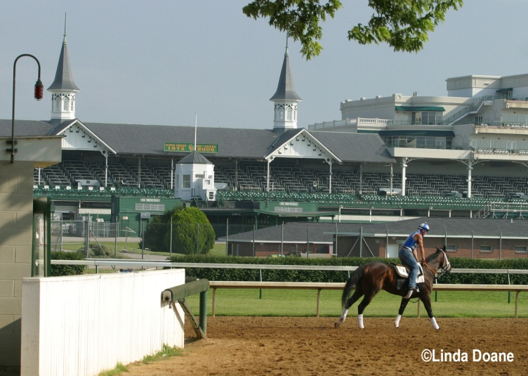
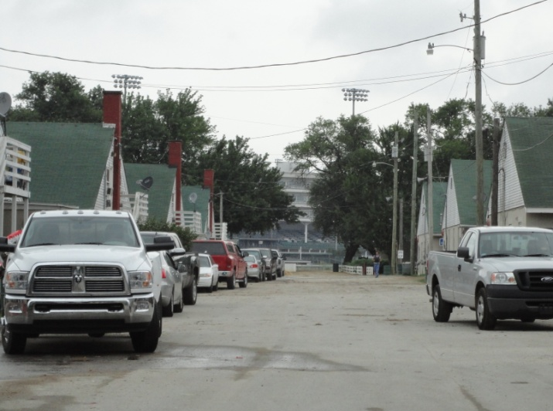
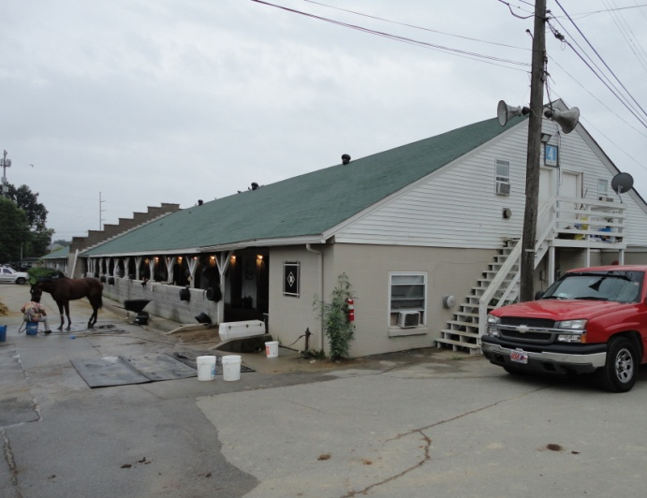
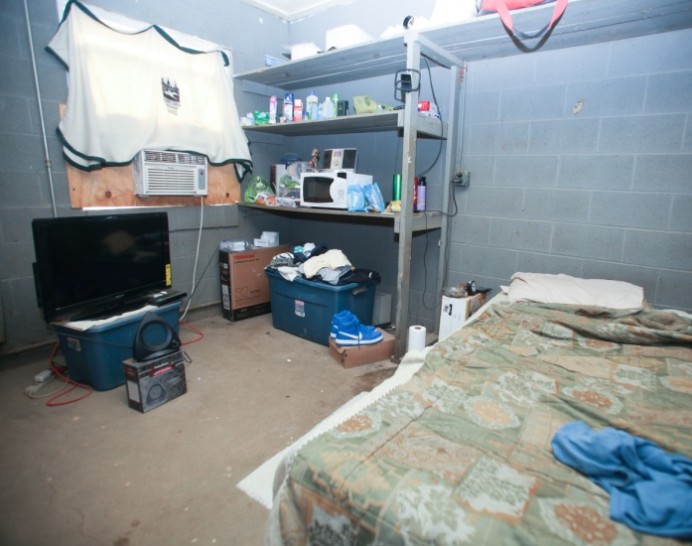
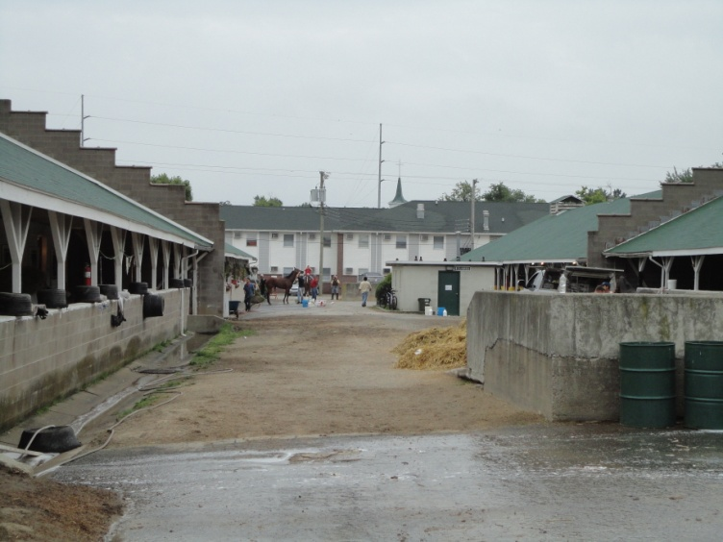
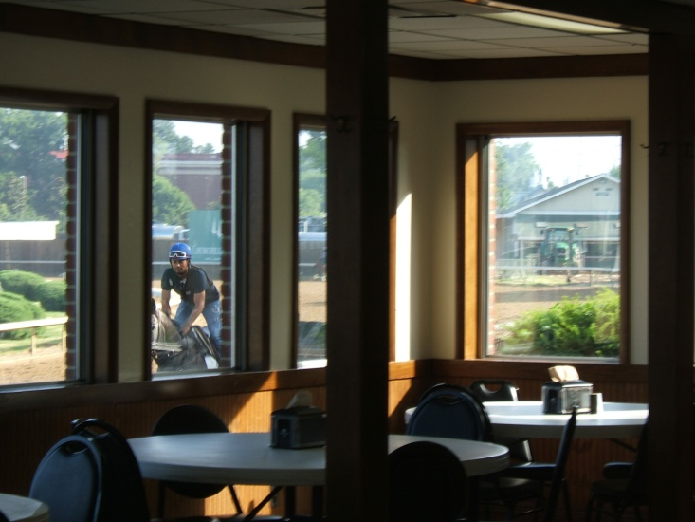
Welcome to the Backside
Sits across from Grandstands | 47 barns with capacity to house 1,400 Thoroughbreds | Some grooms live above the stables in apartments
Interior of stable apartment | More traditional apartment buildings between stables | Post Time kitchen, sits trackside, where a lot of workers eat breakfast & lunch

Slide 6
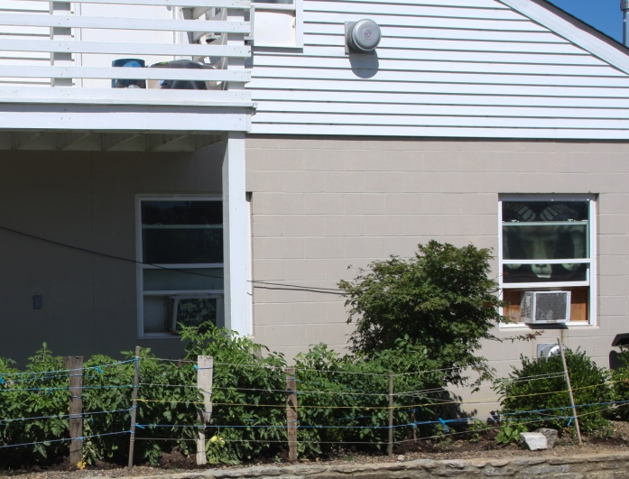
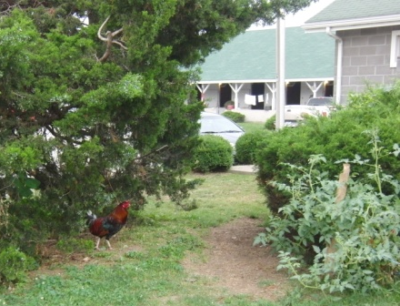
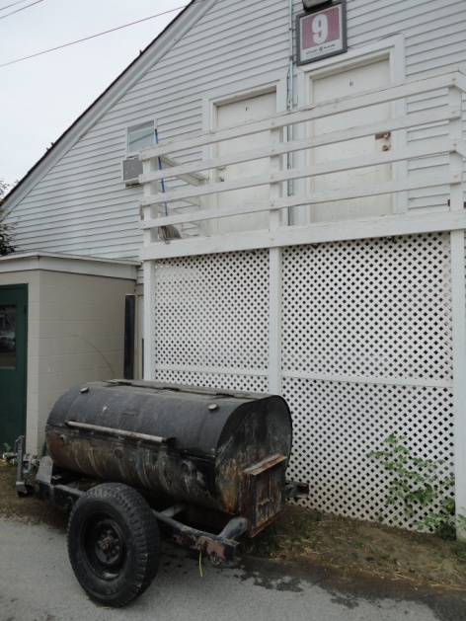
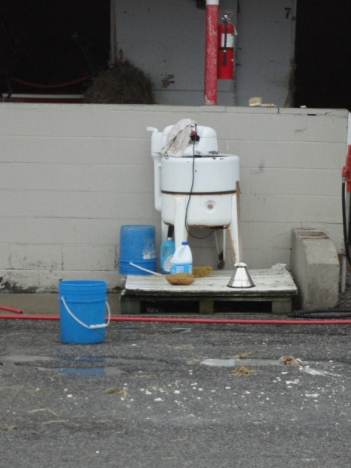
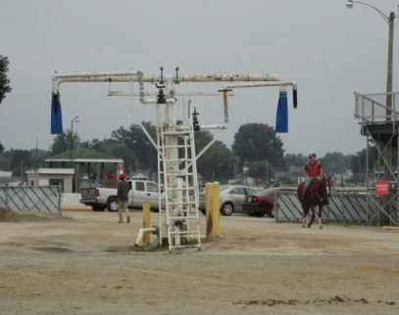
Common Sights
Some cook and will sell food out of coolers | Gardens are sometimes planted outside of barns | Chickens, goats and cats might roam- no dogs!
Meat smokers or grills outside of barns are typical | Old washing machine outside of barn | Water station to refill tanks on water trucks

Slide 7
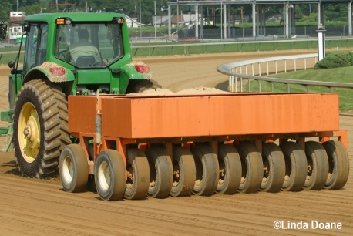
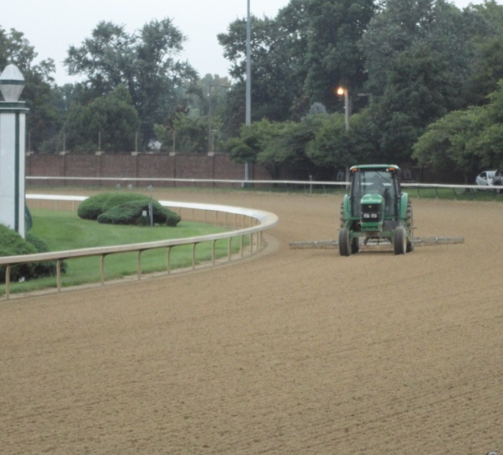
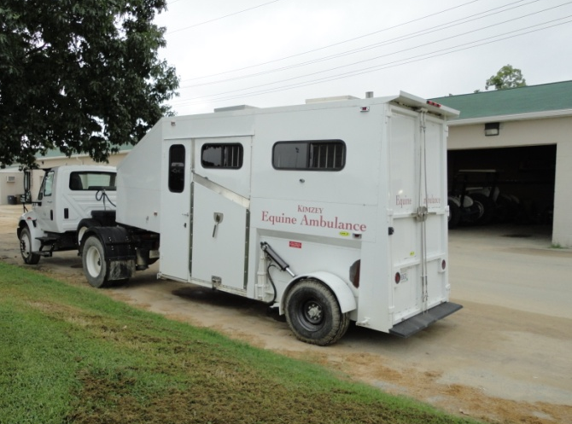
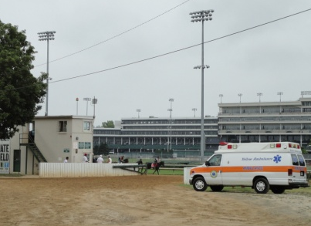
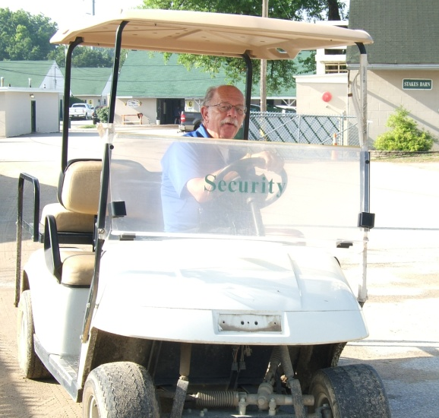
A Team of Workers Dedicated to Track Maintenance
Water trucks moisten track on hot days | Track is 75% Sand, 23% Silt, 2% Clay- tested daily to keep it soft & safe | Tractors harrow (rake) the track often for safety
Horses have ambulances too | Clocker’s stand to time horses -Ambulance always present | Security on hand at all times

Slide 8
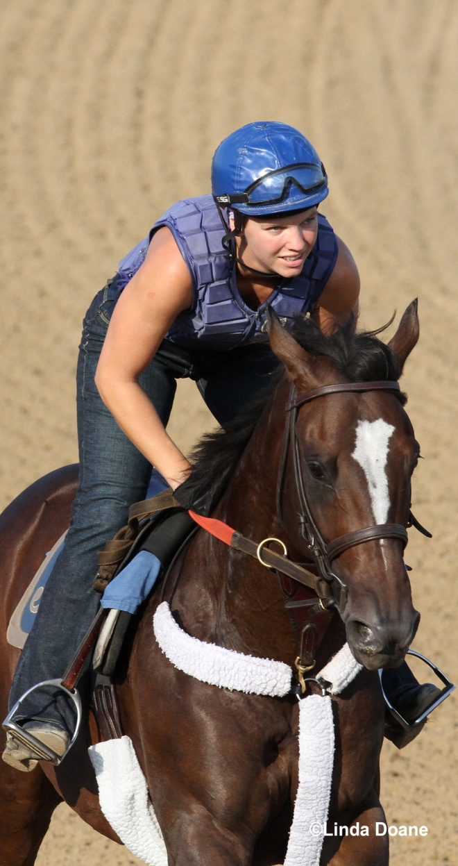
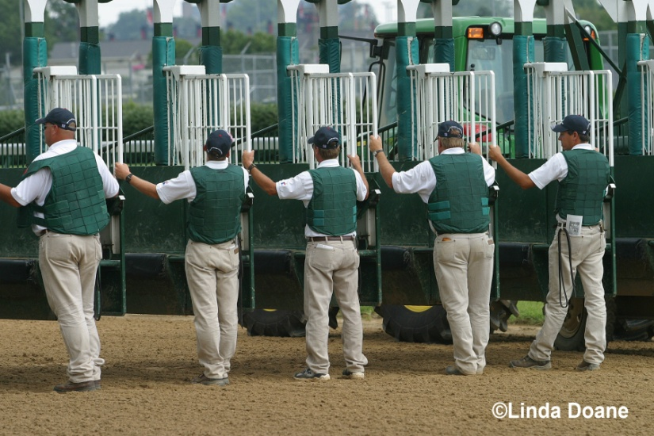
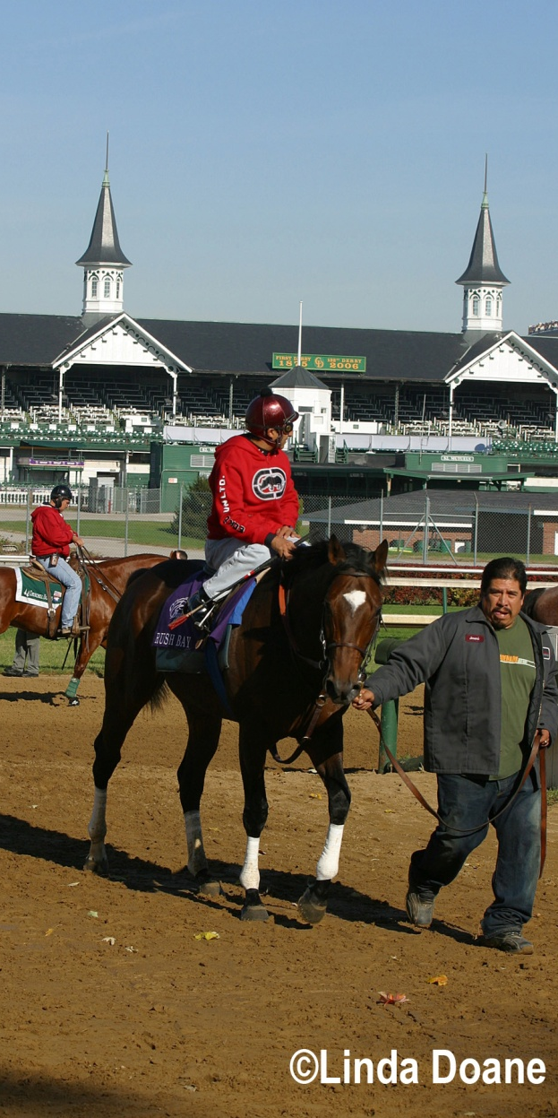
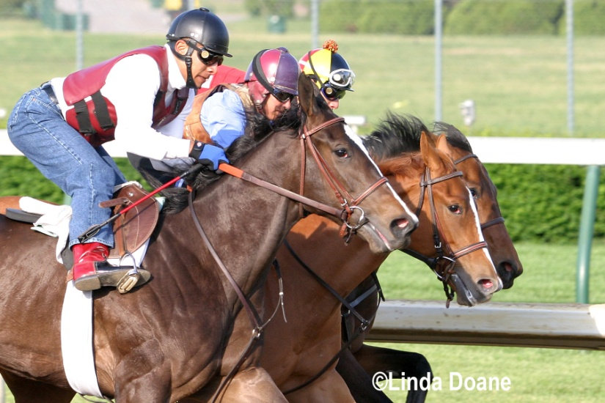
Morning Workouts: 5:30-10 AM Daily
 | Gate Workouts
Exercise rider and safety equipment | 3 Lanes of traffic on racetrack- breezing, galloping and walking | Grooms and exercise riders

Slide 9
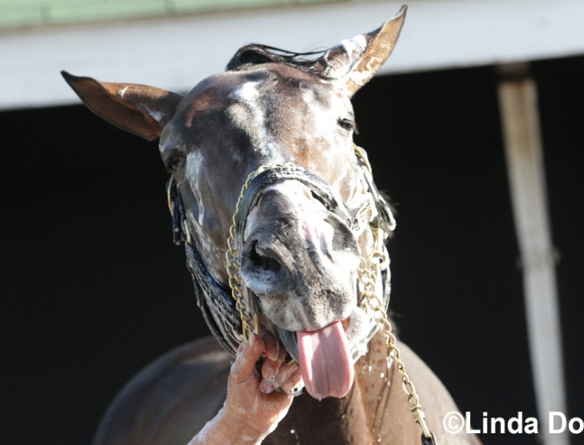
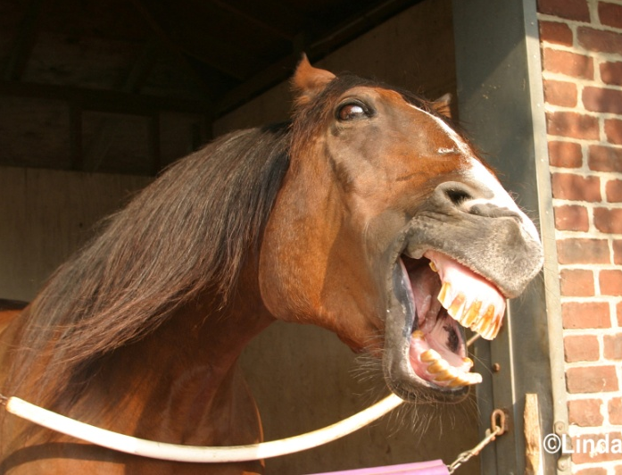
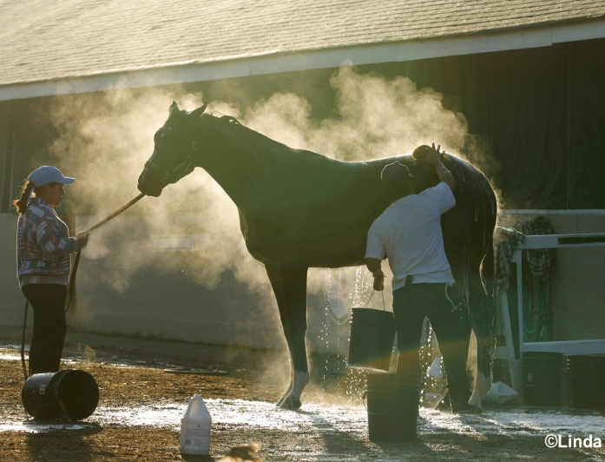
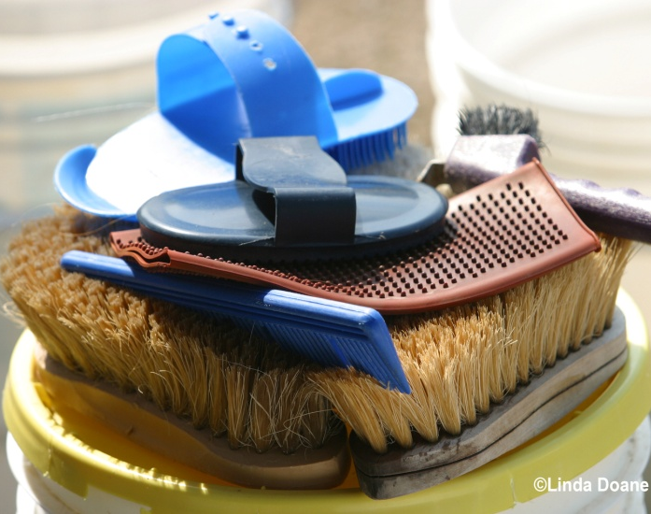
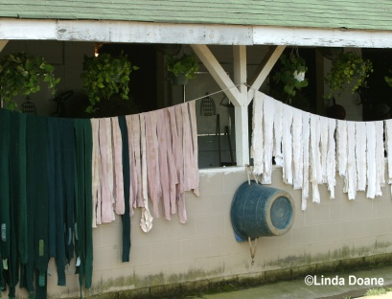
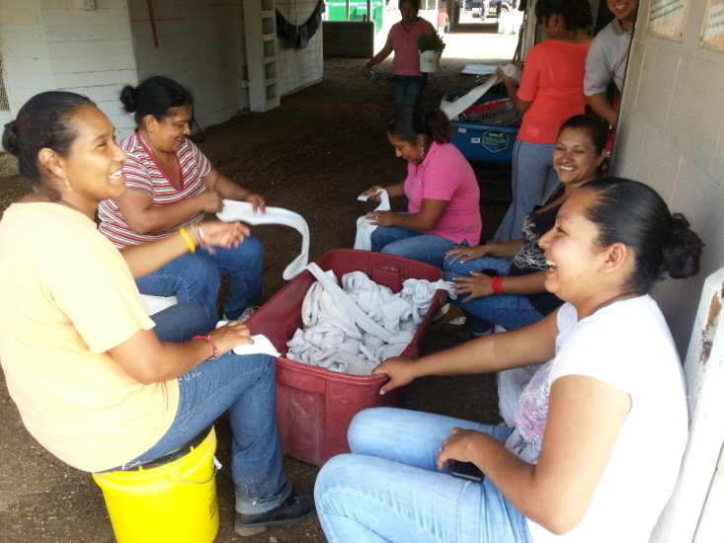
Grooming the Horse after Workouts
Horses have different personalities | Some like to bite | Grooming is a two person job
Some of the equipment to groom a horse | Leg wraps for the horse | Washing leg wraps

Slide 10
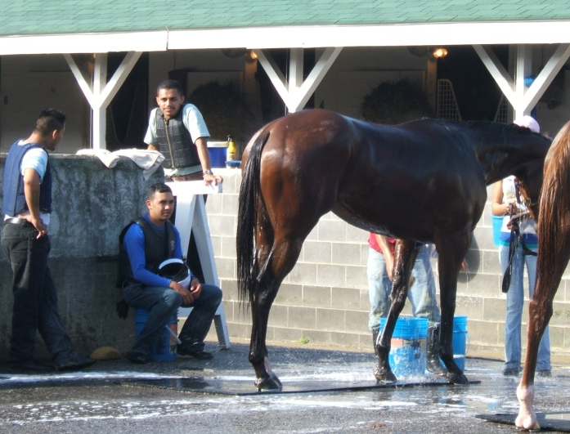
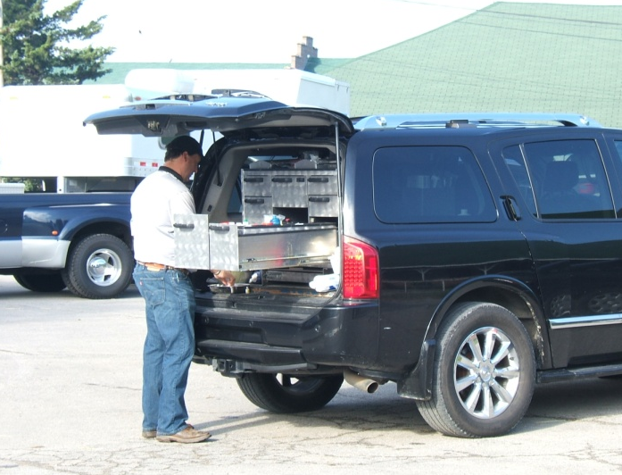
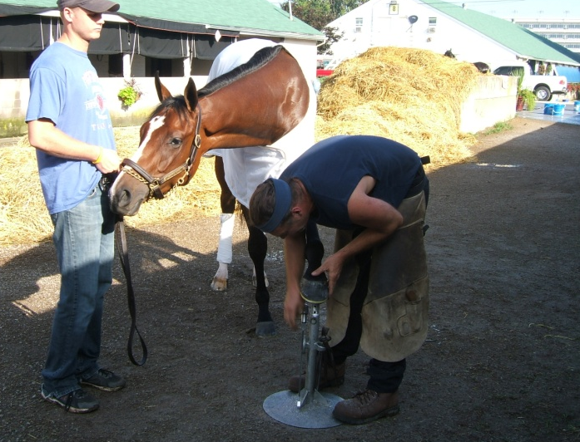
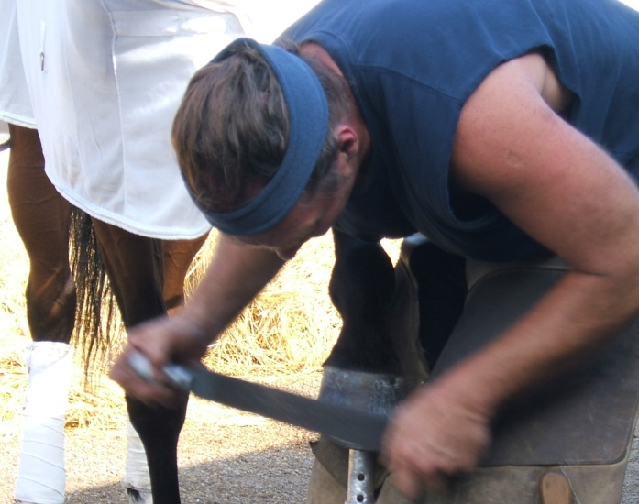
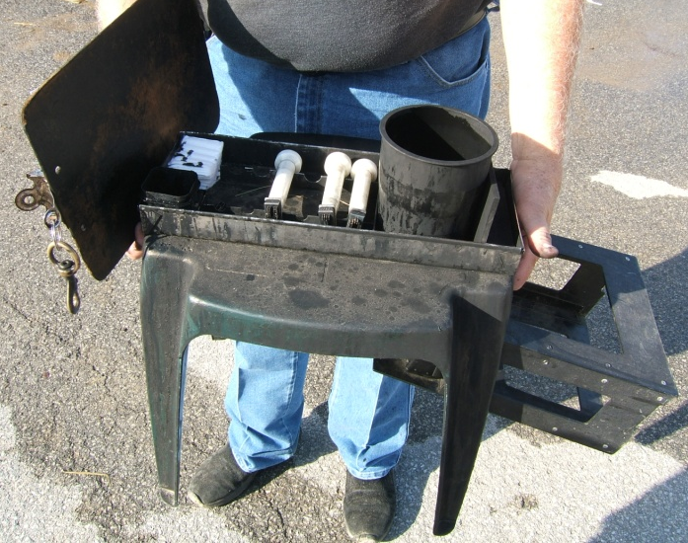
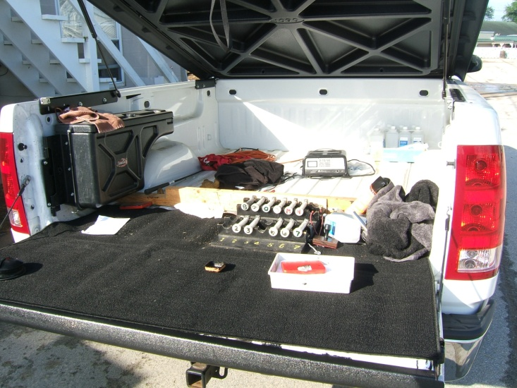
Day to Day Life
Exercise riders taking a break | Veterinarians work out of the back of a truck | Farrier working on horse
Fitting the horseshoe | Ink kit for lip tattoos, all racehorses have lip tattoo for ID | Your office is the back of your truck!

Slide 11
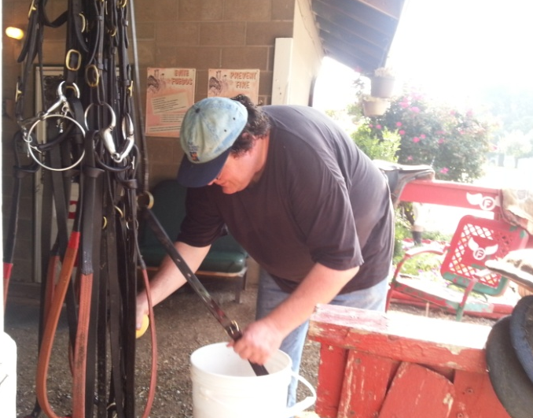
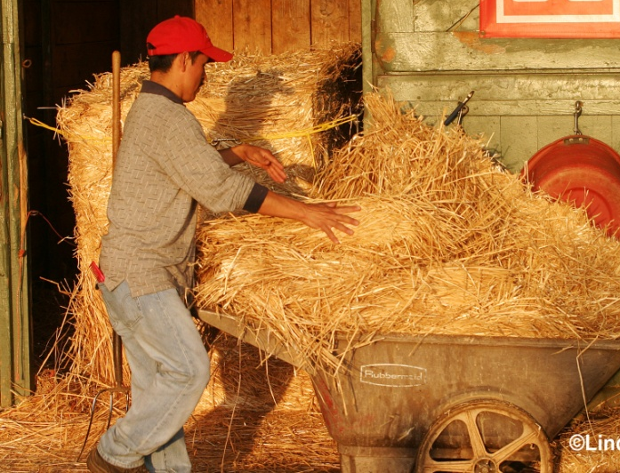
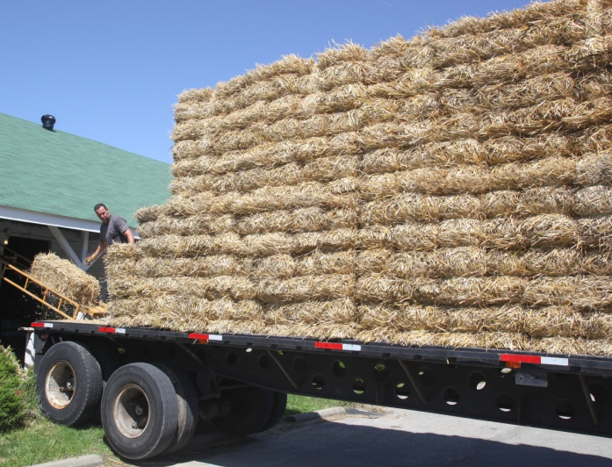
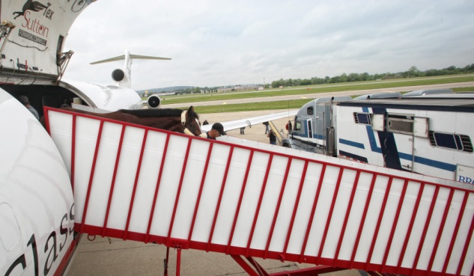
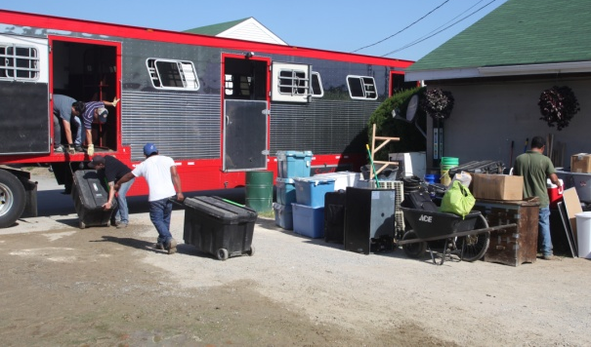
Day to Day Life
Cleaning the tack | Mucking out the stalls | Several tons of hay are used throughout the year
When the horse moves… |  | You move

Slide 12
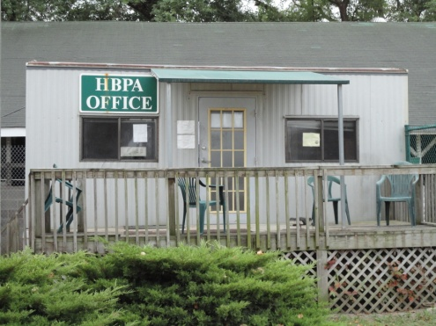
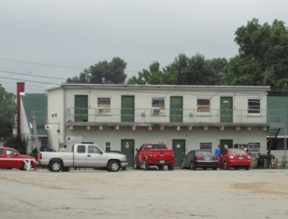
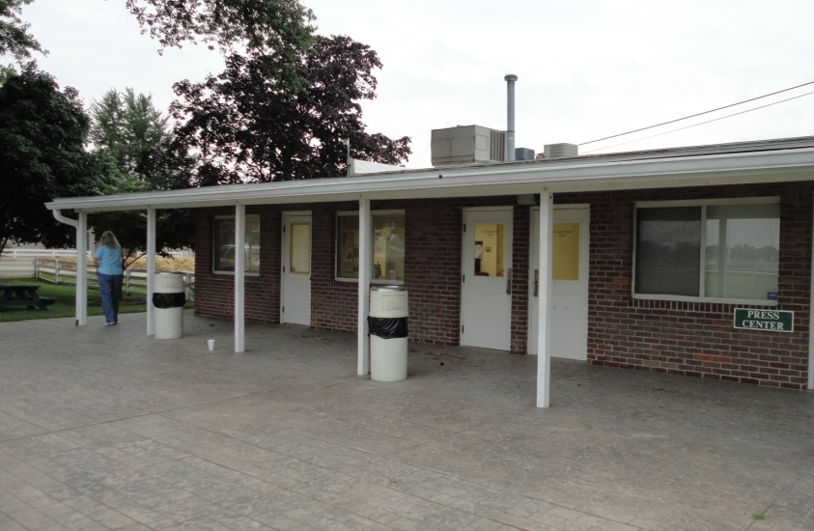
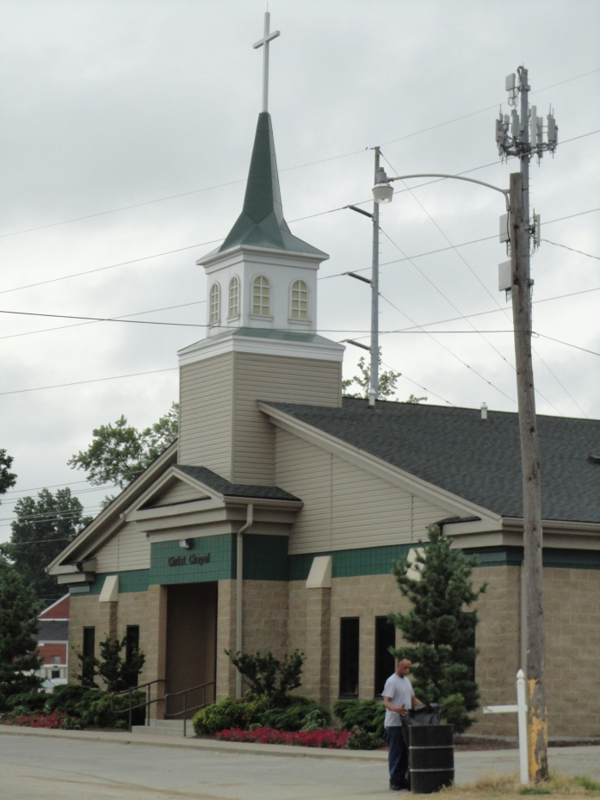
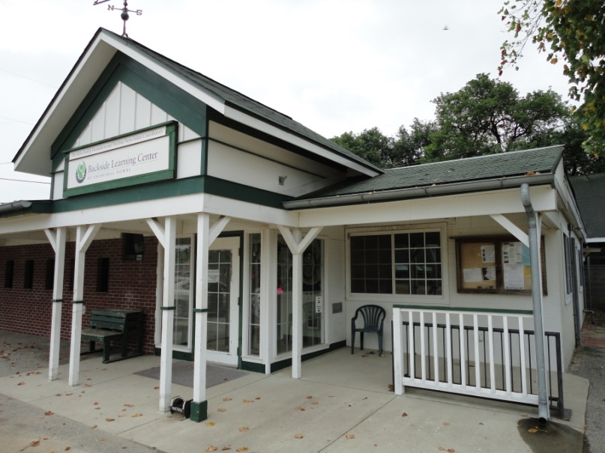
Services on hand to better the life of Backside workers
Churchill Downs Outriders police the racetrack | Horsemen’s Benevolent & Protective Association – protects rights of horsemen | Kentucky Thoroughbred Association – protects rights of Thoroughbred
Lifestyles Program for Backside workers | Chapel | Backside Learning Center offers education programs

Slide 13
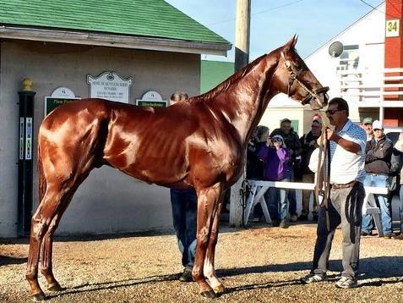
The goal of this community is to keep this horse…
HEALTHY
HAPPY
AND READY TO RUN!

